Slide 1
Deep Learning

Slide 2
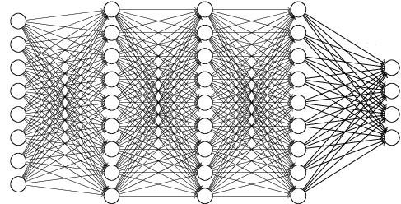
Dense Network
What is the Dense Network?
Consists of multiple Dense layers
Input Layer
Hidden Layer 1
Hidden Layer 2
Hidden Layer 3
Output Layer

Slide 3
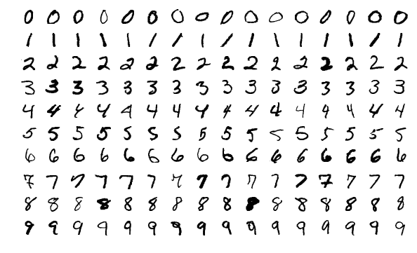
3-layer DN for MNIST
MNIST Dataset
Large data of handwritten digits that is commonly used for training various image processing systems and machine learning
It contains 60,000 training images and 10,000 testing images (28 X 28 pixel)
<Sample images from MNIST test dataset>

Slide 4
3-layer DN for MNIST
Model Overview
.
.
.
.
.
.
.
.
.
Bias
+1
+1
Input Layer
(28*28=784)
Hidden Layer
(800)
Output Layer
(10)

Slide 5
3-layer DN for MNIST
Preparation
MNIST dataset download and load to mnist variable with one_hot label encoding
For example)
0 => <1, 0, 0, 0, 0, 0, 0, 0, 0, 0>
1 => <0, 1, 0, 0, 0, 0, 0, 0, 0, 0>
…
9 => <0, 0, 0, 0, 0, 0, 0, 0, 0, 10>
55,000 grayscale training and 10,000 grayscale test image
import tensorflow as tf import os os.environ['CUDA_VISIBLE_DEVICES'] = "0" config = tf.ConfigProto() config.gpu_options.per_process_gpu_memory_fraction = 0.4 from tensorflow.examples.tutorials.mnist import input_data mnist = input_data.read_data_sets("./dataset/mnist/", one_hot=True)

Slide 6
3-layer DN for MNIST
Setup Placeholders for Data and Label
A image consists of 784 pixels (28X28)
A label consists of 10 classes (0 – 9)
First dimension (None) will index the images in the mini-batch
X = tf.placeholder(tf.float32, [None, 784]) Y = tf.placeholder(tf.float32, [None, 10])

Slide 7
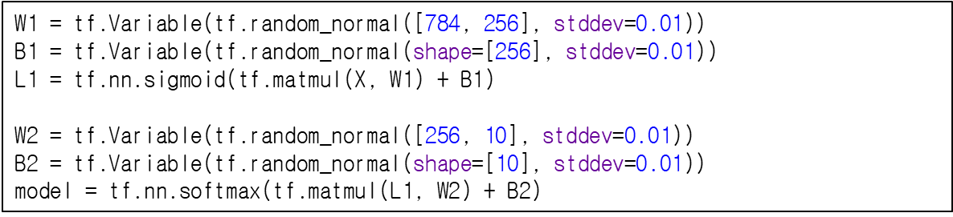
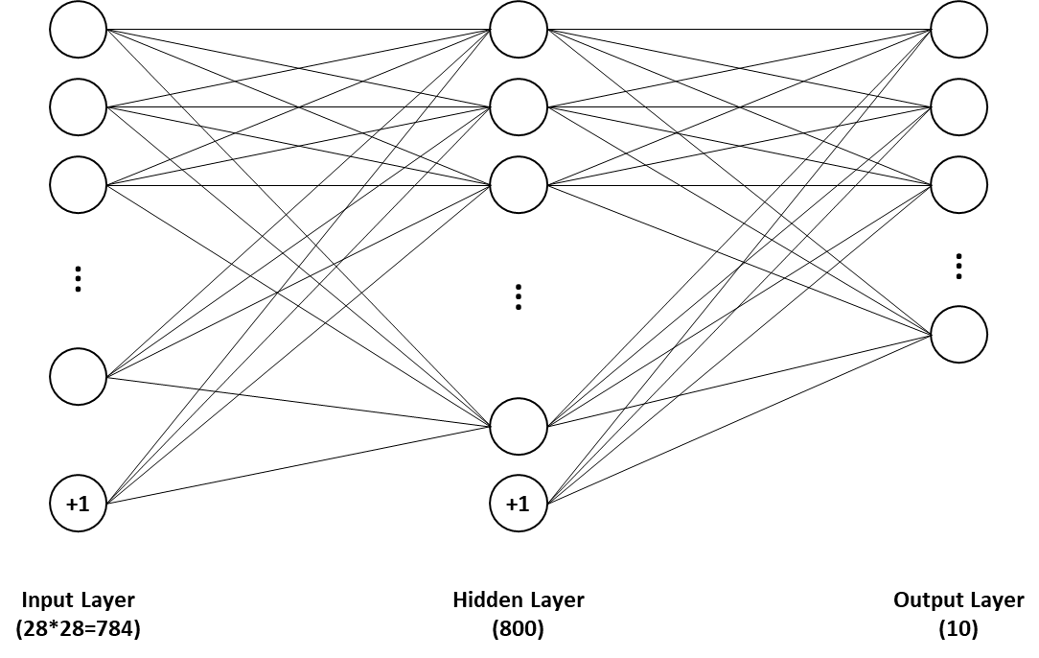
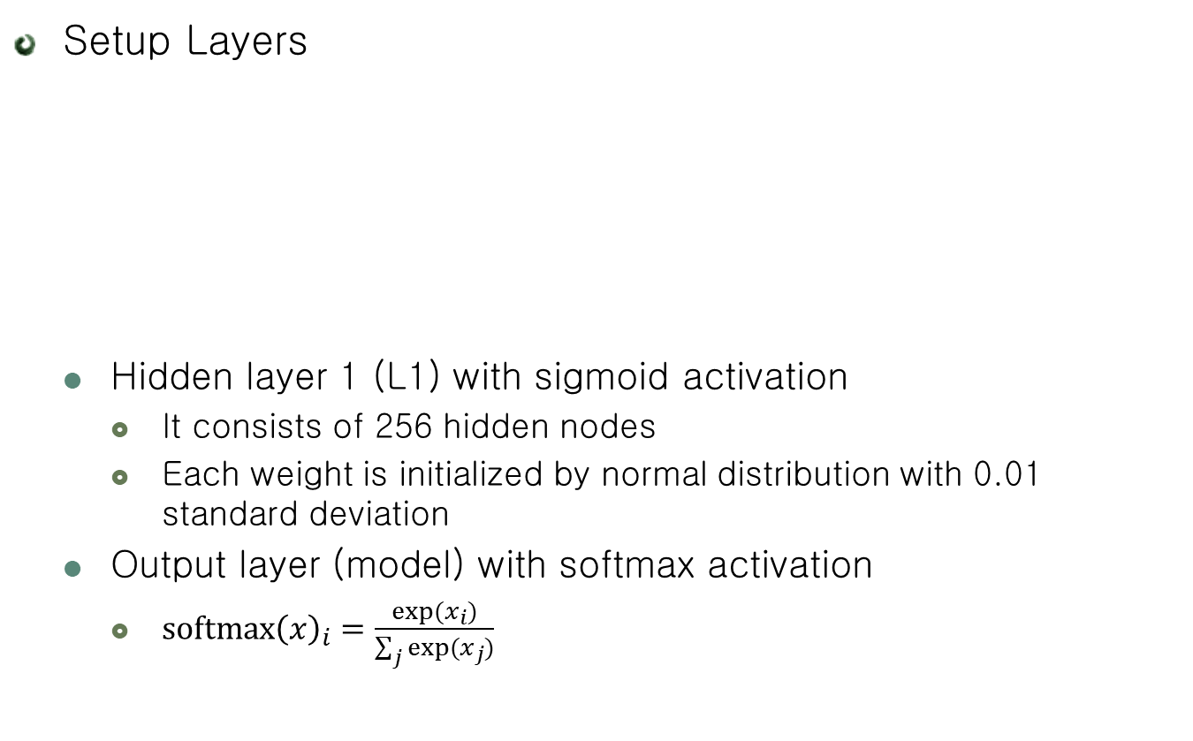
3-layer DN for MNIST
Setup Layers
Hidden layer 1 (L1) with sigmoid activation
It consists of 256 hidden nodes
Each weight is initialized by normal distribution with 0.01 standard deviation
Output layer (model) with softmax activation
$softmax{\left(x\right)}_{i}=\frac{exp⁡(x_{i})}{\sum_{j}{exp⁡(x_{j})}}$

Slide 8
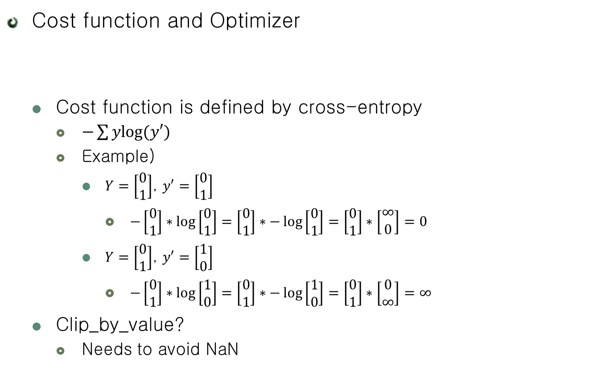
3-layer DN for MNIST
Cost function and Optimizer
Cost function is defined by cross-entropy
$−\sum{ylog⁡(y′)}$
Example)
$Y=\left[\begin{matrix}0 \\ 1\end{matrix}\right]$, $y′=\left[\begin{matrix}0 \\ 1\end{matrix}\right]$
$−\left[\begin{matrix}0 \\ 1\end{matrix}\right]∗\log\left[\begin{matrix}0 \\ 1\end{matrix}\right]=\left[\begin{matrix}0 \\ 1\end{matrix}\right]∗−\log\left[\begin{matrix}0 \\ 1\end{matrix}\right]=\left[\begin{matrix}0 \\ 1\end{matrix}\right]∗\left[\begin{matrix}∞ \\ 0\end{matrix}\right]=0$
$Y=\left[\begin{matrix}0 \\ 1\end{matrix}\right]$, $y′=\left[\begin{matrix}1 \\ 0\end{matrix}\right]$
$−\left[\begin{matrix}0 \\ 1\end{matrix}\right]∗\log\left[\begin{matrix}1 \\ 0\end{matrix}\right]=\left[\begin{matrix}0 \\ 1\end{matrix}\right]∗−\log\left[\begin{matrix}1 \\ 0\end{matrix}\right]=\left[\begin{matrix}0 \\ 1\end{matrix}\right]∗\left[\begin{matrix}0 \\ ∞\end{matrix}\right]=∞$
Clip_by_value?
Needs to avoid NaN
cost = tf.reduce_mean(-tf.reduce_sum(Y * tf.log(tf.clip_by_value(model, 1e-10, 1.0)), [1]))
optimizer = tf.train.AdamOptimizer(0.001).minimize(cost)

Slide 9
3-layer DN for MNIST
Cost function and Optimizer
Create an operation to initialize the variables
Launch the model in a Session
init = tf.global_variables_initializer() sess = tf.Session(config=config) sess.run(init)

Slide 10
3-layer DN for MNIST
Setup for mini-batch
Mini-batch
Weight update by using subset’s loss
Reduces the variance of the gradient
Avoids large memory usage
batch_size = 100 total_batch = int(mnist.train.num_examples / batch_size)

Slide 11

3-layer DN for MNIST
Setup for Accuracy
is_correct
Are they equal between model and Y
For example
$model=\left[0, 0, 0, 1\right], Y=[0, 0, 0, 1]$
$eq\left(3, 3\right)=True$
$model=\left[0, 0, 0, 1\right], Y=[0, 0, 1, 0]$
$eq\left(3, 2\right)=False$
is_correct = tf.equal(tf.argmax(model, 1), tf.argmax(Y, 1)) accuracy = tf.reduce_mean(tf.cast(is_correct, tf.float32))

Slide 12
3-layer DN for MNIST
Training!
Model update by using mini-batch
Total epoch is 15
for epoch in range(15): total_cost = 0 for i in range(total_batch): batch_xs, batch_ys = mnist.train.next_batch(batch_size) _, cost_val = sess.run([optimizer, cost], feed_dict={X: batch_xs, Y: batch_ys}) total_cost += cost_val print('Epoch:', '%04d' % (epoch + 1), 'Avg. cost =', '{:.3f}'.format(total_cost / total_batch), 'Train Acc. =', sess.run(accuracy, feed_dict={X: mnist.train.images, Y: mnist.train.labels}))

Slide 13
3-layer DN for MNIST
Evaluation for Test Dataset
print('Training Done!') print('Test Acc. = ', sess.run(accuracy, feed_dict={X: mnist.test.images, Y: mnist.test.labels}))
sess.close()

Slide 14
3-layer DN for MNIST
Run!
Epoch: 0001 Avg. cost = 0.602 Train Acc. = 0.921564
Epoch: 0002 Avg. cost = 0.237 Train Acc. = 0.942364
Epoch: 0003 Avg. cost = 0.183 Train Acc. = 0.956073
Epoch: 0004 Avg. cost = 0.149 Train Acc. = 0.962818
Epoch: 0005 Avg. cost = 0.124 Train Acc. = 0.970236
Epoch: 0006 Avg. cost = 0.104 Train Acc. = 0.974636
Epoch: 0007 Avg. cost = 0.089 Train Acc. = 0.978891
Epoch: 0008 Avg. cost = 0.076 Train Acc. = 0.982455
Epoch: 0009 Avg. cost = 0.066 Train Acc. = 0.9858
Epoch: 0010 Avg. cost = 0.057 Train Acc. = 0.987036
Epoch: 0011 Avg. cost = 0.049 Train Acc. = 0.989909
Epoch: 0012 Avg. cost = 0.043 Train Acc. = 0.991382
Epoch: 0013 Avg. cost = 0.037 Train Acc. = 0.992018
Epoch: 0014 Avg. cost = 0.032 Train Acc. = 0.994618
Epoch: 0015 Avg. cost = 0.027 Train Acc. = 0.995582
Training Done!
Test Acc. = 0.9784

Slide 15
3-layer DN for MNIST
Code (1)
import tensorflow as tf import os os.environ['CUDA_VISIBLE_DEVICES'] = "0" config = tf.ConfigProto() config.gpu_options.per_process_gpu_memory_fraction = 0.4 from tensorflow.examples.tutorials.mnist import input_data mnist = input_data.read_data_sets("./dataset/mnist/", one_hot=True)

Slide 16
3-layer DN for MNIST
Code (2)
X = tf.placeholder(tf.float32, [None, 784]) Y = tf.placeholder(tf.float32, [None, 10]) W1 = tf.Variable(tf.random_normal([784, 256], stddev=0.01)) B1 = tf.Variable(tf.random_normal(shape=[256], stddev=0.01)) L1 = tf.nn.sigmoid(tf.matmul(X, W1) + B1) W2 = tf.Variable(tf.random_normal([256, 10], stddev=0.01)) B2 = tf.Variable(tf.random_normal(shape=[10], stddev=0.01)) model = tf.nn.softmax(tf.matmul(L1, W2) + B2) cost = tf.reduce_mean(-tf.reduce_sum(Y * tf.log(tf.clip_by_value(model, 1e-10, 1.0)), [1])) optimizer = tf.train.AdamOptimizer(0.001).minimize(cost)
init = tf.global_variables_initializer() sess = tf.Session(config=config) sess.run(init)

Slide 17
3-layer DN for MNIST
Code (2)
batch_size = 100 total_batch = int(mnist.train.num_examples / batch_size) is_correct = tf.equal(tf.argmax(model, 1), tf.argmax(Y, 1)) accuracy = tf.reduce_mean(tf.cast(is_correct, tf.float32)) for epoch in range(15): total_cost = 0 for i in range(total_batch): batch_xs, batch_ys = mnist.train.next_batch(batch_size) _, cost_val = sess.run([optimizer, cost], feed_dict={X: batch_xs, Y: batch_ys}) total_cost += cost_val print('Epoch:', '%04d' % (epoch + 1), 'Avg. cost =', '{:.3f}'.format(total_cost / total_batch), 'Train Acc. =', sess.run(accuracy, feed_dict={X: mnist.train.images, Y: mnist.train.labels})) print('Training Done!') print('Test Acc. = ', sess.run(accuracy, feed_dict={X: mnist.test.images, Y: mnist.test.labels}))
sess.close()

Slide 18
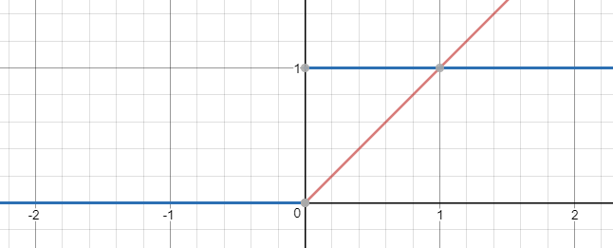

ReLU
Rectified Linear Unit
$f\left(x\right)=max⁡(0, x)$
Robust vanishing gradient!

Slide 19
ReLU
Modify the model structure
…
L1 = tf.nn.relu(tf.matmul(X, W1) + B1) …
L2 = tf.nn.relu(tf.matmul(L1, W2) + B2) …
L3 = tf.nn.relu(tf.matmul(L1, W2) + B2) …

Slide 20
Dropout
Modify the model structure
“keep_prob” is a placeholder for probability to keep
keep_prob = tf.placeholder(tf.float32) …
L1 = tf.nn.relu(tf.matmul(X, W1) + B1) L1 = tf.nn.dropout(L1, keep_prob) …
L2 = tf.nn.relu(tf.matmul(L1, W2) + B2) L2 = tf.nn.dropout(L2, keep_prob) …
L3 = tf.nn.dropout(L3, keep_prob)

Slide 21
Dropout
Feed the keep_prob
Feeding the “keep_prob” when only training
...
_, cost_val = sess.run([optimizer, cost], feed_dict={X: batch_xs, Y: batch_ys, keep_prob: 0.5}) total_cost += cost_val print('Epoch:', '%04d' % (epoch + 1), 'Avg. cost =', '{:.3f}'.format(total_cost / total_batch), 'Train Acc. =', sess.run(accuracy, feed_dict={X: mnist.train.images, Y: mnist.train.labels, keep_prob: 1.0})) print('Training Done!') print('Test Acc. = ', sess.run(accuracy, feed_dict={X: mnist.test.images, Y: mnist.test.labels, keep_prob: 1.0}))

Slide 22
Batch Normalization
Code (1)
X = tf.placeholder(tf.float32, [None, 784])
Y = tf.placeholder(tf.float32, [None, 10])
is_training = tf.placeholder(tf.bool)
epsilon = 1e-3

Slide 23
Batch Normalization
Code (2)
W1 = tf.Variable(tf.random_normal([784, 1024], stddev=0.01))
L1 = tf.matmul(X, W1)
L1 = tf.contrib.layers.batch_norm(L1, is_training=is_training, center=True, scale=True, updates_collections=None)
L1 = tf.nn.sigmoid(L1)
W2 = tf.Variable(tf.random_normal([1024, 512], stddev=0.01))
L2 = tf.matmul(L1, W2)
L2 = tf.contrib.layers.batch_norm(L2, is_training=is_training, center=True, scale=True, updates_collections=None)
L2 = tf.nn.sigmoid(L2)
W3 = tf.Variable(tf.random_normal([512, 256], stddev=0.01))
L3 = tf.matmul(L2, W3)
L3 = tf.contrib.layers.batch_norm(L3, is_training=is_training, center=True, scale=True, updates_collections=None)
L3 = tf.nn.sigmoid(L3)

Slide 24
Batch Normalization
Code (3)
W4 = tf.Variable(tf.random_normal([256, 10], stddev=0.01))
B4 = tf.Variable(tf.random_normal(shape=[10], stddev=0.01))
model = tf.nn.softmax(tf.matmul(L3, W4) + B4)
cost = tf.reduce_mean(-tf.reduce_sum(Y * tf.log(tf.clip_by_value(model, 1e-10, 1.0)), [1]))
optimizer = tf.train.AdamOptimizer(0.001).minimize(cost)
init = tf.global_variables_initializer()
sess = tf.Session(config=config)
sess.run(init)
batch_size = 100
total_batch = int(mnist.train.num_examples / batch_size)
is_correct = tf.equal(tf.argmax(model, 1), tf.argmax(Y, 1))
accuracy = tf.reduce_mean(tf.cast(is_correct, tf.float32))

Slide 25
Batch Normalization
Code (4)
for epoch in range(15):
total_cost = 0
for i in range(total_batch):
batch_xs, batch_ys = mnist.train.next_batch(batch_size)
_, cost_val = sess.run([optimizer, cost], feed_dict={X: batch_xs, Y: batch_ys, is_training: True})
total_cost += cost_val
print('Epoch:', '%04d' % (epoch + 1), 'Avg. cost =', '{:.3f}'.format(total_cost / total_batch),
'Train Acc. =', sess.run(accuracy, feed_dict={X: mnist.train.images, Y: mnist.train.labels, is_training: False}))
print('Training Done!')
print('Test Acc. = ', sess.run(accuracy, feed_dict={X: mnist.test.images, Y: mnist.test.labels, is_training: False}))
sess.close()

Slide 26
Practice: 5-layer DN for MNIST
Model Overview
Input Layer
(784)
Hidden Layer 1
(1024)
Hidden Layer 2
(512)
Hidden Layer 3
(256)
Output Layer
(10)

Slide 27
Practice: 5-layer DN for MNIST
Code
keep_prob = tf.placeholder(tf.float32) is_training = tf.placeholder(tf.bool) epsilon = 1e-3 W1 = tf.Variable(tf.random_normal([784, 256], stddev=0.01)) B1 = tf.Variable(tf.random_normal(shape=[256], stddev=0.01)) L1 = tf.matmul(X, W1) + B1 L1 = tf.contrib.layers.batch_norm(L1, is_training=is_training, center=True, scale = True, updates_collections=None) L1 = tf.nn.relu(L1) L1 = tf.nn.dropout(L1, keep_prob)
…

Slide 28
Practice: 5-layer DN for MNIST
Run!
Model | 3-layer
Acc. | 0.9784
Epoch: 0001 Avg. cost = 0.336 Train Acc. = 0.9554727
Epoch: 0002 Avg. cost = 0.174 Train Acc. = 0.9654727
Epoch: 0003 Avg. cost = 0.142 Train Acc. = 0.9807636
Epoch: 0004 Avg. cost = 0.121 Train Acc. = 0.9831273
Epoch: 0005 Avg. cost = 0.110 Train Acc. = 0.9839636
Epoch: 0006 Avg. cost = 0.101 Train Acc. = 0.98521817
Epoch: 0007 Avg. cost = 0.091 Train Acc. = 0.9876
Epoch: 0008 Avg. cost = 0.085 Train Acc. = 0.9892182
Epoch: 0009 Avg. cost = 0.079 Train Acc. = 0.99005455
Epoch: 0010 Avg. cost = 0.073 Train Acc. = 0.9922182
Epoch: 0011 Avg. cost = 0.072 Train Acc. = 0.99143636
Epoch: 0012 Avg. cost = 0.066 Train Acc. = 0.9908
Epoch: 0013 Avg. cost = 0.064 Train Acc. = 0.9928182
Epoch: 0014 Avg. cost = 0.060 Train Acc. = 0.99521816
Epoch: 0015 Avg. cost = 0.058 Train Acc. = 0.99416363
Training Done!
Test Acc. = 0.9803

